Slide 1
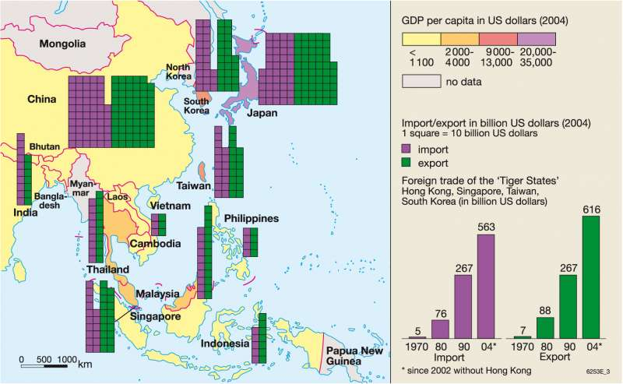
Economic Geography of East Asia

Slide 2
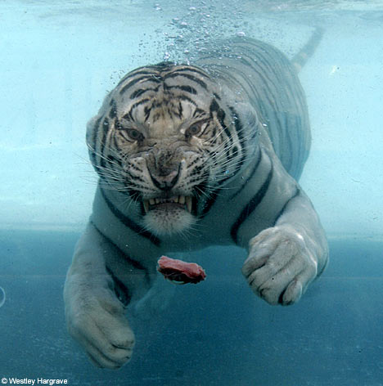
Economic Tigers / Newly Industrialized Countries
Newly Industrialized countries = NIC’s = Four Dragons = Four Tigers
Hong Kong, S Korea, Singapore, Taiwan
A rapidly growing economy specializing in small electronic manufacturing and light industry

Slide 3
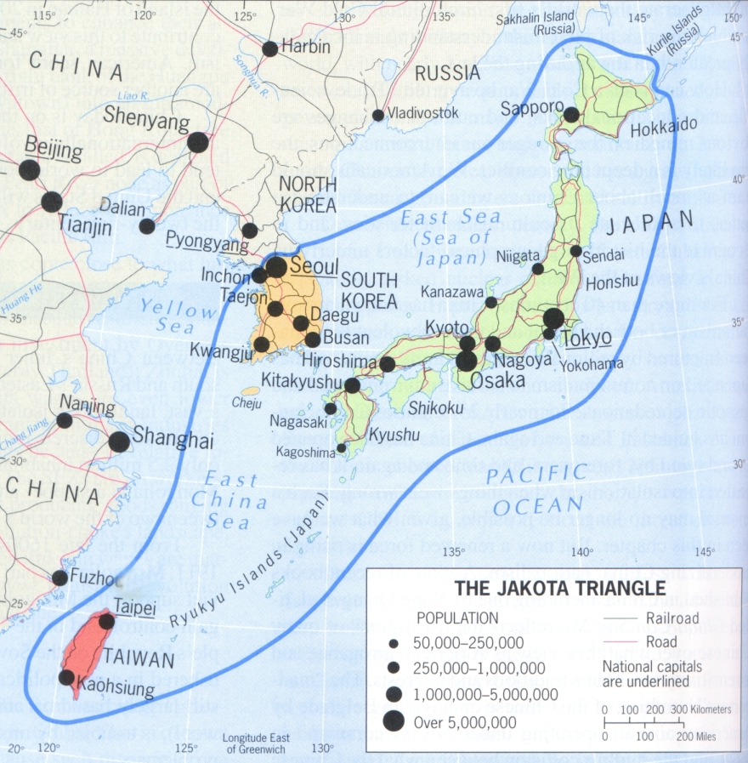
Jakota Triangle

Slide 4
Economic Recession of the 1990s
What is an economic recession?
Causes:
1. Global competition reduce Japanese profits
2. Investors/banks lost money on Japanese investments
3. People stopped spending
4. Japanese economy stagnant

Slide 5
Chinese Economic Change
Move from command to capitalism

Slide 6
Globalization / Global Supply Chain
the world is connected economically
Global Supply Chain

Slide 7
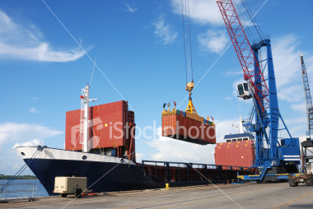
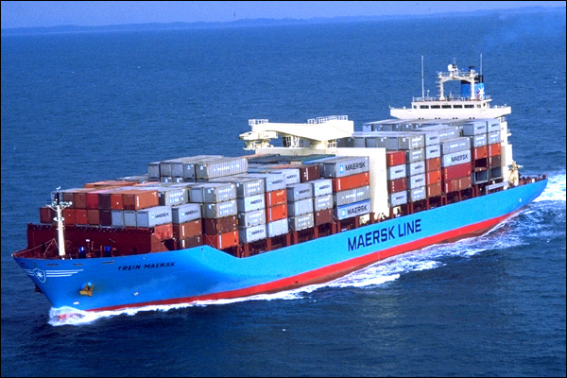
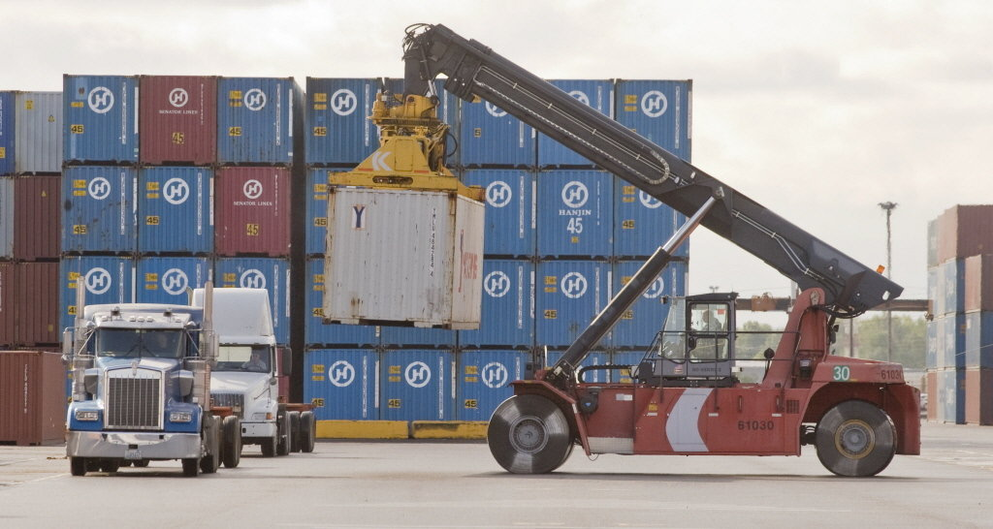
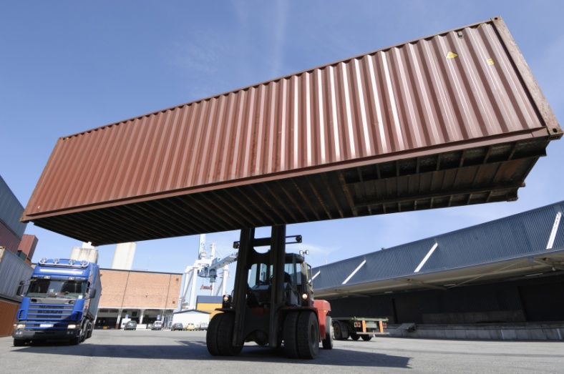
Containerized Shipping
Standard size containers speed up shipping, loading, unloading and reduce shipping costs

