Slide 1
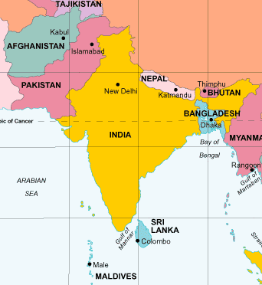
Physical Geography of South Asia

Slide 2
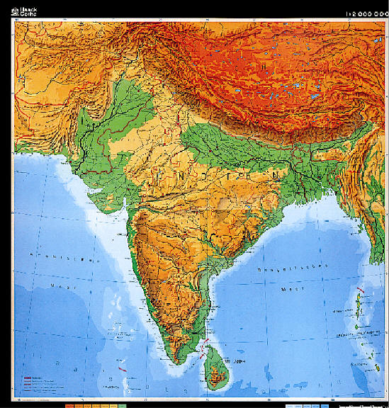
Pattern of landforms
Yellow:
Purple:
Red:

Slide 3
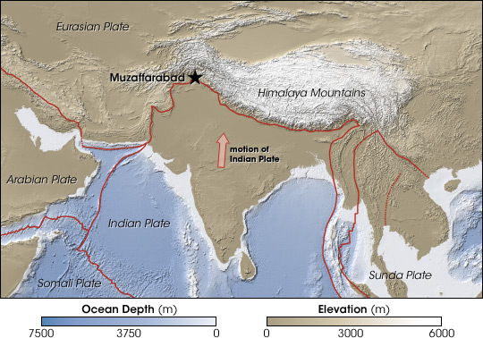
Tectonic action
Which two plates collide?
What type of plate boundary?
What landform results?

Slide 4
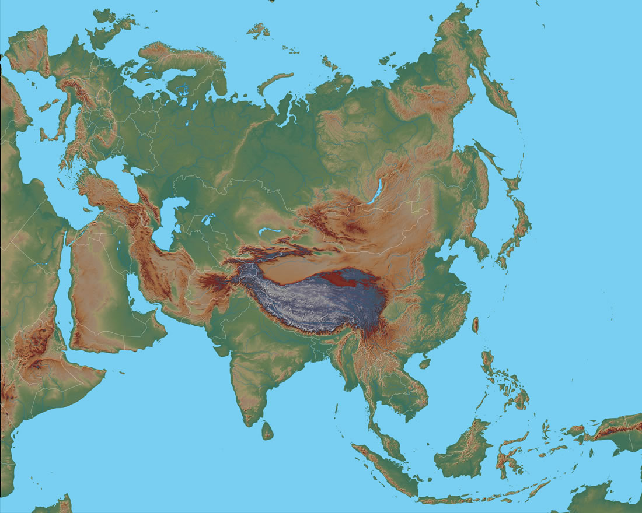
subcontinent
If Asia is a continent,
why is South Asia
a “subcontinent”?

Slide 5
Mountain Ranges
Blue:
Yellow:

Slide 6
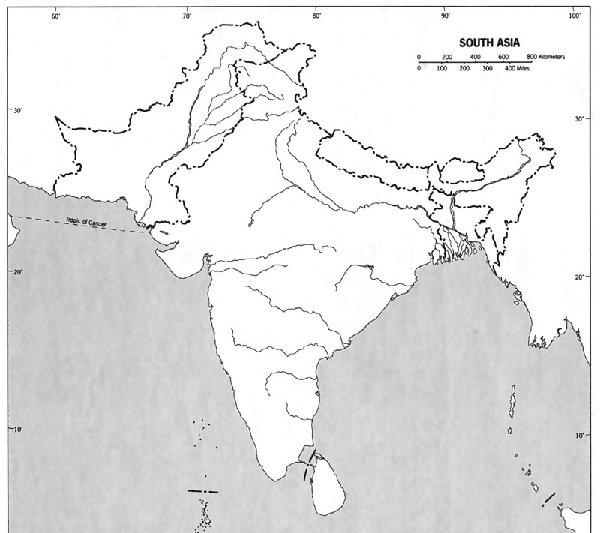
Major Rivers
Blue:
Yellow:
Purple:

Slide 7
Major Rivers
In what country would you find the deltas for the Ganges and Brahmaputra river?

Slide 8
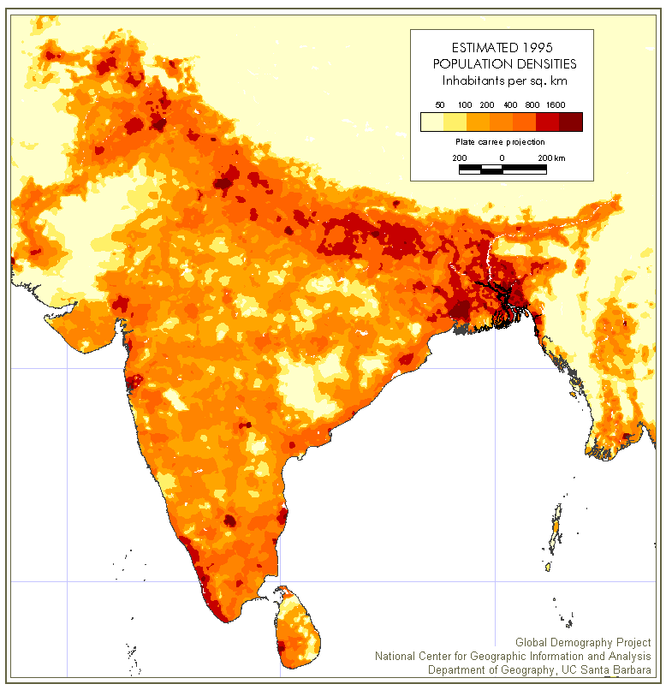
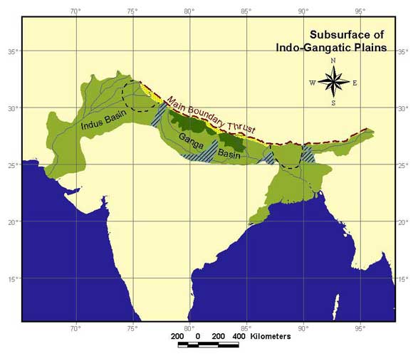
Indo-Gangetic Plain
Looking at the two
images, what is
important about the
Indo-Gangetic Plain?

Slide 9
Alluvial Plains
How are alluvial
plains formed?
Why would alluvial
plains be able to
support large
populations?

Slide 10
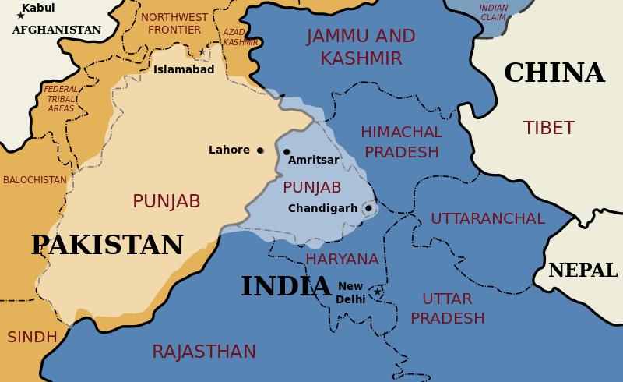
The Punjab
What religion/ethnic group claims Punjab as it’s historical homeland?

Slide 11
Deccan Plateau

Slide 12
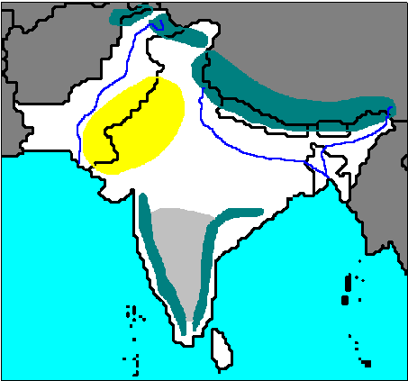
Eastern/Western Ghats
Western Ghats
Eastern Ghats
What is a ghat? (not the Varanasi ghats but the landform)

Slide 13
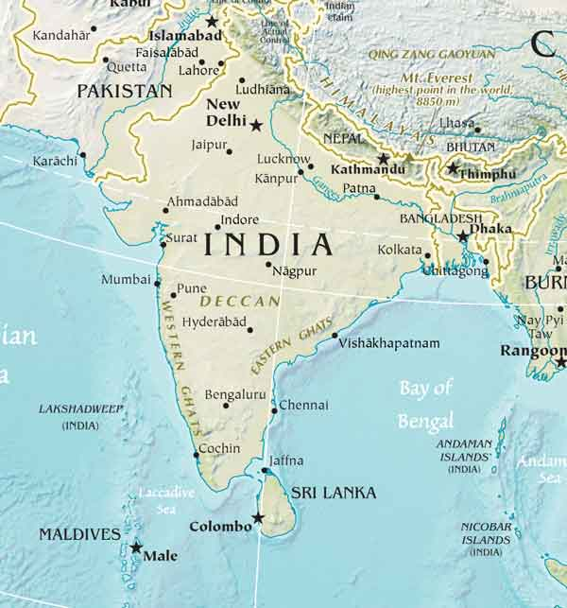
archipelago
Maldives and the
Andaman Islands
are both archipelagos.
What is an archipelago?

Slide 14
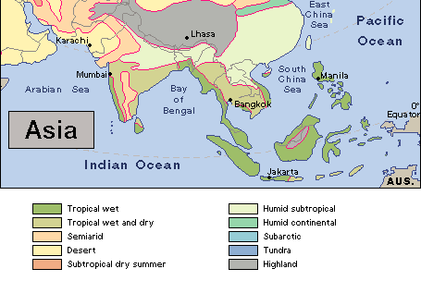
Pattern of climate in South Asia
Describe temperature and precipitation levels in South Asia as you move from west to east?
What is the dominate climate in the west of South Asia? The east?

Slide 15
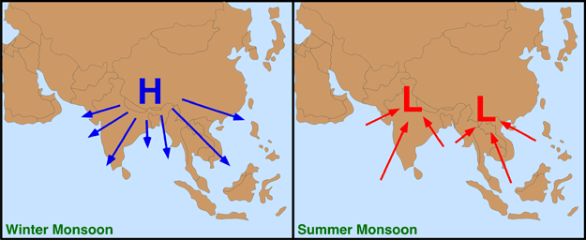
Monsoons
The monsoon is a seasonal shift in the prevailing winds over South Asia. You will need to know why the winds shift as well as which monsoon is wet and which is dry.

Slide 16
Monsoons
Why does a low pressure system form of South Asia in the summer?

Slide 17
Monsoons
In the summer, will the air over South Asia have high or low levels of humidity? Why?

Slide 18
Monsoons
What major barrier will the monsoon winds eventually strike in northern India?
What is this type of precipitation called?

Slide 19
Monsoons
Is the summer monsoon wet or dry?

Slide 20
Monsoons
Why will a high pressure system form of eastern China during the winter?

Slide 21
Monsoons
Will the air of the winter monsoon have high or low levels of humidity? Why?

Slide 22
Monsoons
Is the winter monsoon wet or dry?

Slide 23
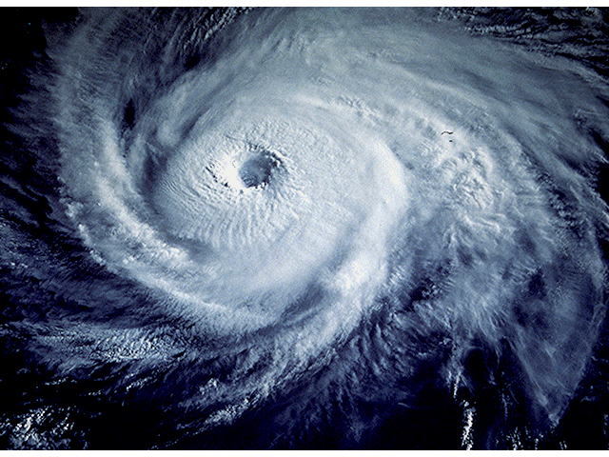
Natural Hazards: Cyclone
This is a satellite image of a cyclone. What do we call cyclones in the USA?

Slide 24
Natural Hazards: storm surge
Re-write this definition so a 10 year old could understand it.

Slide 25
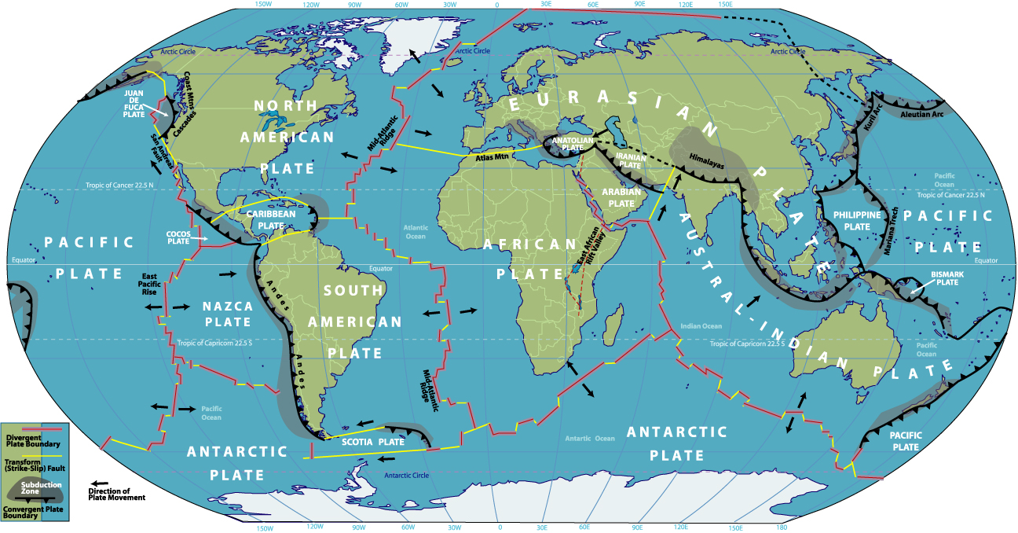
Natural Hazards: tsunami
Circle the area on the above map that would most likely cause a tsunami to strike South Asia.

