Slide 1
Urban Geography: Site Factors for Cites; Urbanization; Urban Models;

Slide 2
Locational factors of early and modern cities Learning Target
I can locate and describe human and physical features that influence the size and distribution of settlements. (WG.6.A)

Slide 3
Locational Factors for Early Cities (early = pre industrialization)
1. Defense
2. Fertile Soil
3. Food
4. Fresh Water
5. Fuel for personal consumption
Building materials
Key resources

Slide 4
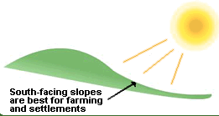
Locational Factors for Early Cities
Notes:
South facing slopes are the best for farming in the Northern Hemisphere

Slide 5
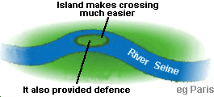
Locational Factors for Early Cities
A river crossing

Slide 6
Locational Factors for Early Cities
The floor of a river valley.
Notes:
In mountainous areas where winds are strong and most land is steep and rugged the floor of the river valley may provide the only protected level site for a village

Slide 7
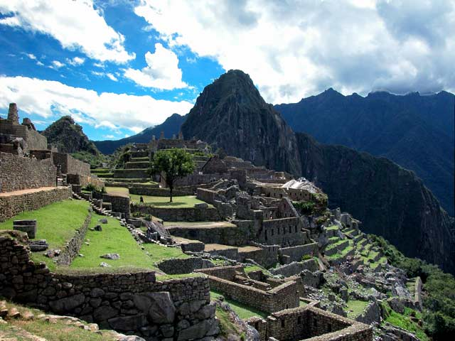
Locational Factors for Early Cities
Machu Pichu
Notes:
Hilltop religious site

Slide 8
Site Factors for Settlements:
A hilltop city

Slide 9
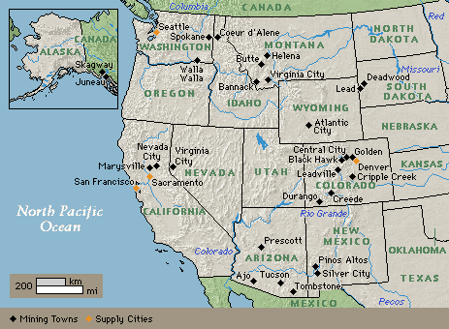
Site Factors for Settlements:
Mining towns

Slide 10
Site Factors for Settlements:
At a desert oasis

Slide 11
Site Factors for Modern Cities (modern = after industrialization)
Source of Power
Ability to Trade

Slide 12
Site Factors for Modern Cities

Slide 13
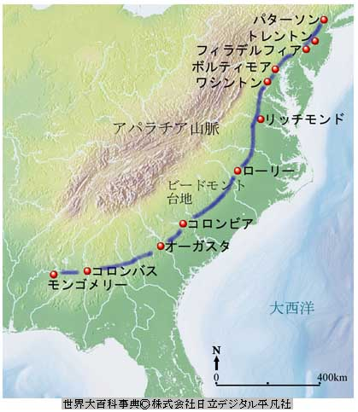
Site Factors for Modern Cities
The Fall Line
Trenton NJ
Philadelphia PA
Baltimore MD
Washington D.C.
Richmond VA
Raleigh NC
Columbia SC
Atlanta GA
Montgomery, AL
Jackson, MS
Notes:
It is an important resource. Waterfalls. Low east facing cliff paralleling the Atlantic Ocean from New Jersey to Carolinas.

Slide 14
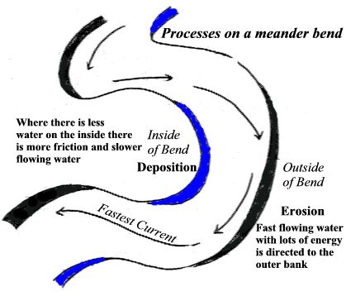
Site Factors for Modern Cities
Outside of a river’s meander
Notes:
Allows easy access to fresh water. The water is deeper and land less likely to be marshy

Slide 15
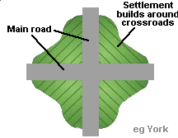
Site Factors for Modern Cities
At a crossroads
Notes:
The flow of traffic is concentrated

Slide 16
Site Factors for Modern Cities at the highest navigable point of a river

Slide 17
Urbanization Learning Target
I can explain the processes that have caused changes in settlement patterns, including urbanization, transportation, access to and availability of resources and economic activities.

Slide 18
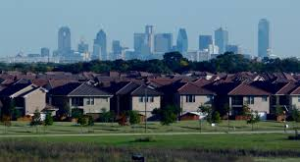
Suburbs
A residential or mixed use area that is either part of a city or as a separate residential community within a commuting distance.

Slide 19
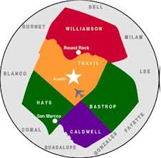
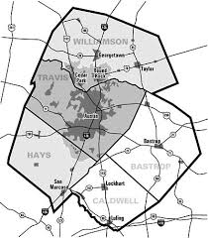
Metropolitan Area
The urban core of a city along with its suburbs and exurbs.

Slide 20
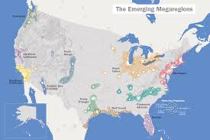
Megalopolis
Also known as a super city. When metropolitan areas grow together. BOSNYWASH-Boston, NY, Washington D.C.

Slide 21
What is Urbanization?

Slide 22
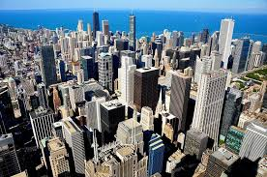
Central Business District (CBD)
The commercial and business center of the city. Located in the heart of downtown.

Slide 23
Why is Urbanization more prevalent in Developing or Less Developed Countries?

Slide 24
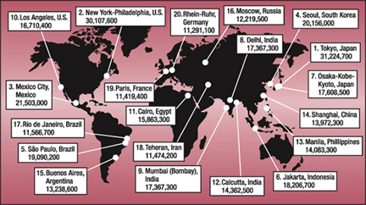
What common characteristics are shared by megacites?

Slide 25
Urban Models / Land Use Patterns
Urban Models show changing land usage in cities as forms of transportations change

Slide 26
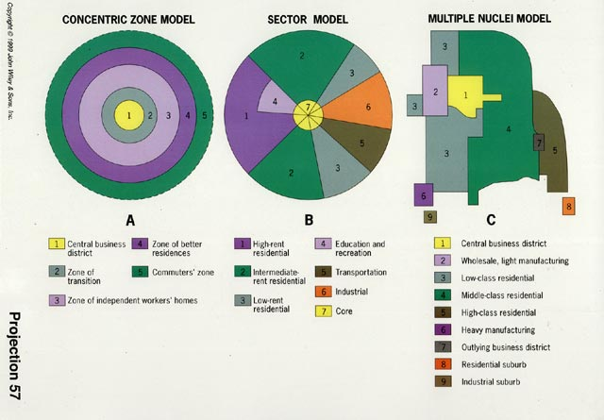
How are cities organized?
Traditional models of urban structure:

Slide 27
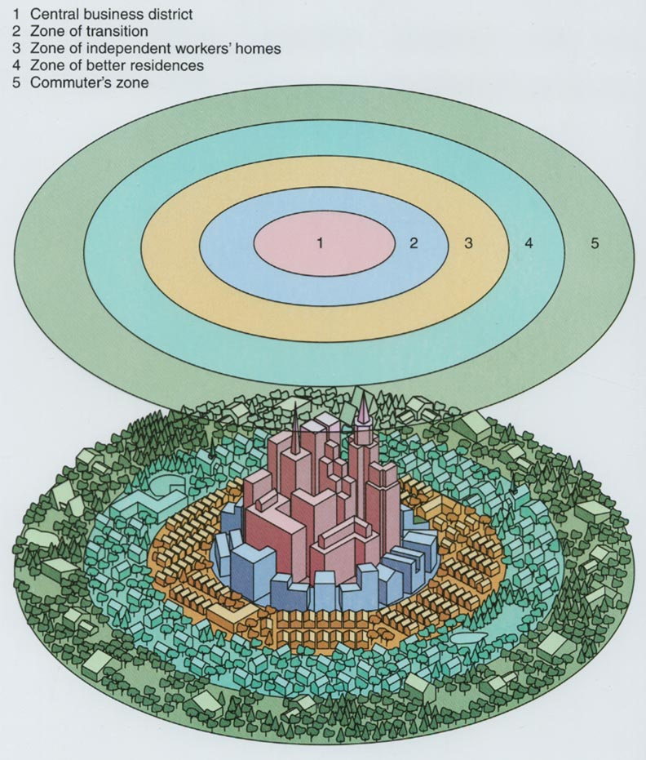
How are cities organized?
The Concentric Zone Model reflects the walking-horsecar era--early 20th century.
Notes:
By Ernest Burgess’s study of Chicago in the 1920’s. Divides city into 5 concentric zones defined by their function.
Central business district (financial, retail, theater)
Residential deterioration and encroachment by businesses and light manufacturing
Independent workers homes
Middle class residents
Suburban ring/commuter zone

Slide 28
Central Business District (downtown)
The densest area of a city with the most expensive land costs.
How does this fact explain the types of buildings found in the CBD?

Slide 29
Suburbs
Land cheaper, houses bigger

Slide 30
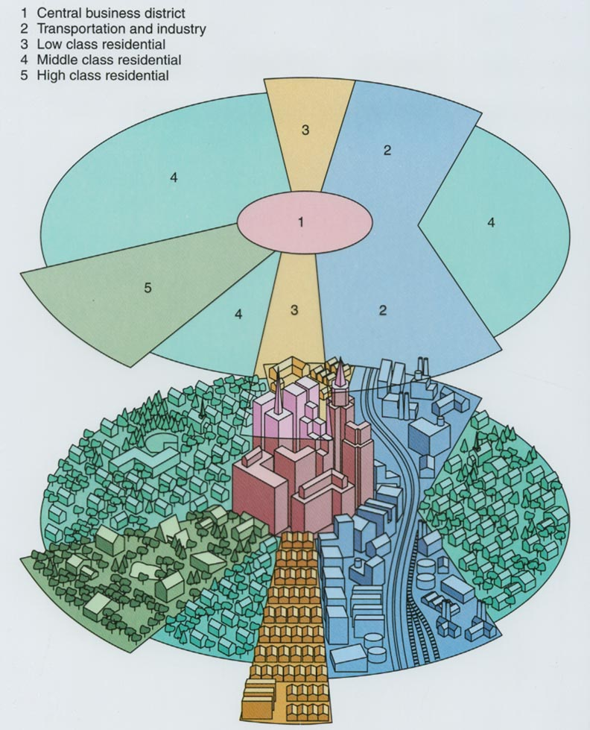
How are cities organized?
The Sector Model reflects the influence of transportation corridors.
Notes:
By Homer Hoyt. Pie shaped zones because of transportation

Slide 31
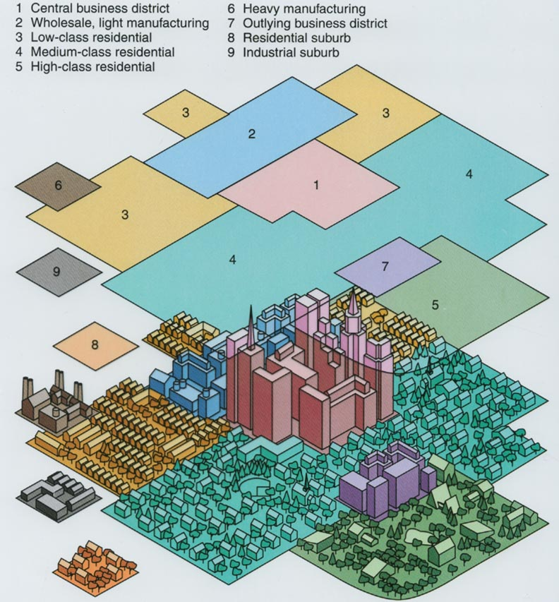
How are cities organized?
The Multiple Nuclei Model reflects the influence of the automobile on suburbanization.
Notes:
The Central Business District (CBD) is losing its dominant position as the single nucleus of an urban area.

Slide 32
Present-day United States metropolitan area.

Slide 33
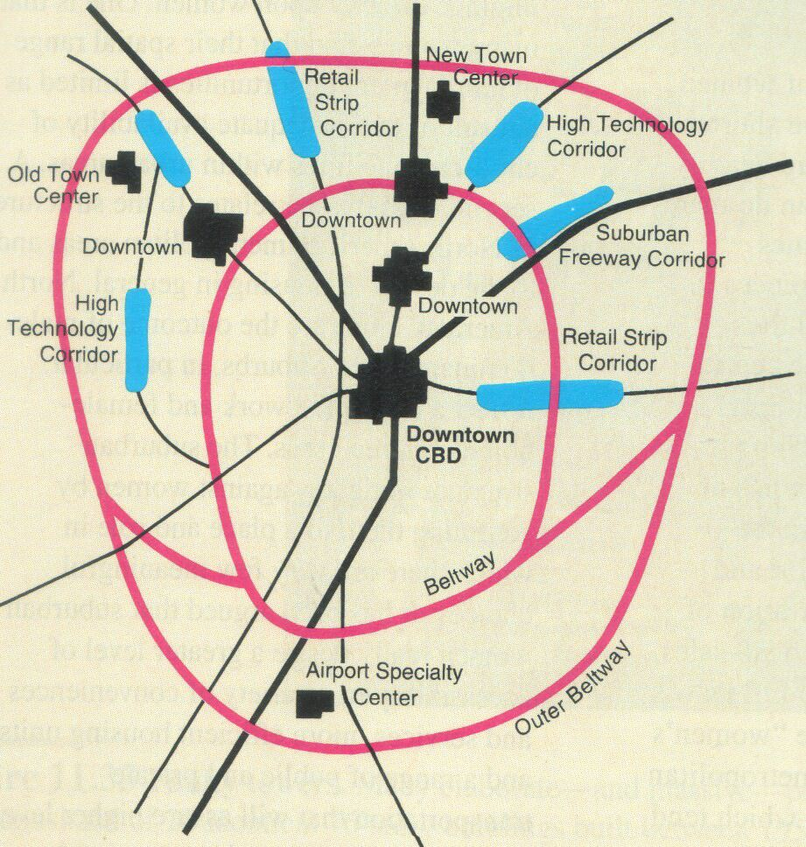
The Galactic City

Slide 34
