Slide 1
Urban Geography in Latin America

Slide 2
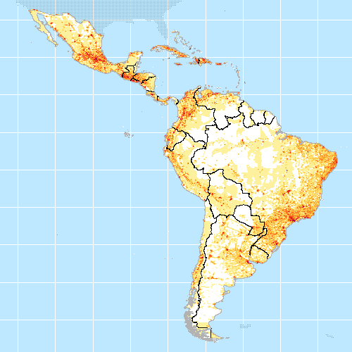
Learning Target: What effects do landforms have on population distribution? What landforms account for population distribution in Latin America?

Slide 3
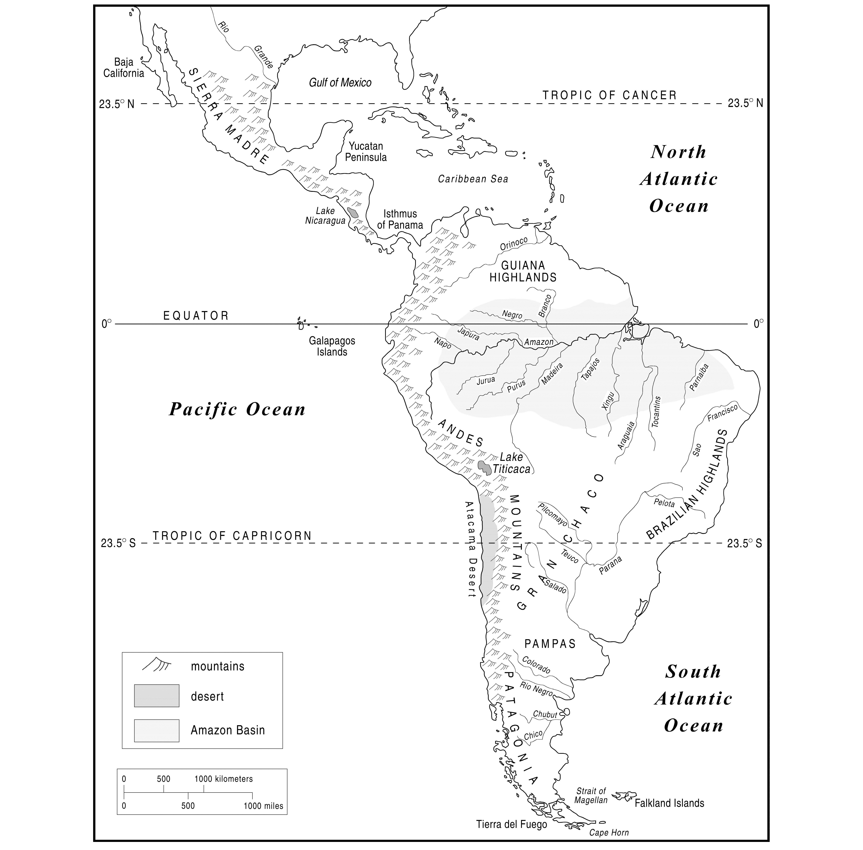

Slide 4
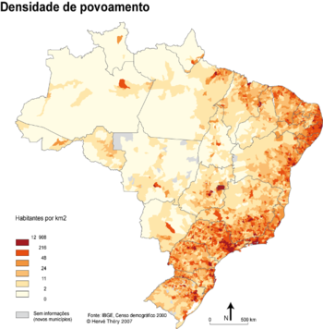
Using this population density map, why was the capital of Brazil moved to Brasilia?
Brasilia

Slide 5
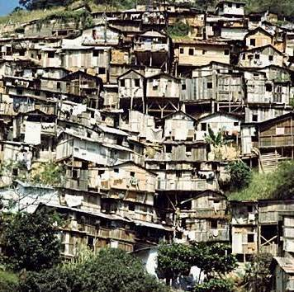
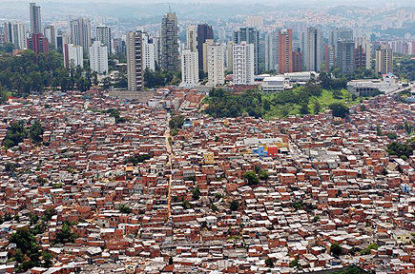
Favelas

