Slide 1
Secular
Not associated with religion
Separation of Church (religion) and State (leadership/laws of a country)

Slide 2
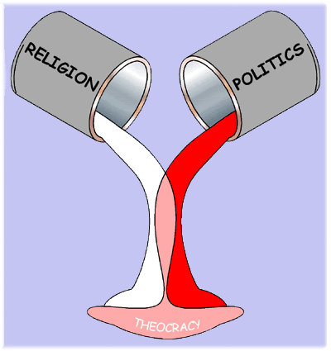
Theocracy
A system of government in which a country is ruled by religious leaders (Iran)

Slide 3
Fundamentalist
A person that strictly adheres a religion.
The term “fundamentalist” is often used incorrectly by those actually meaning “extremist”

Slide 4
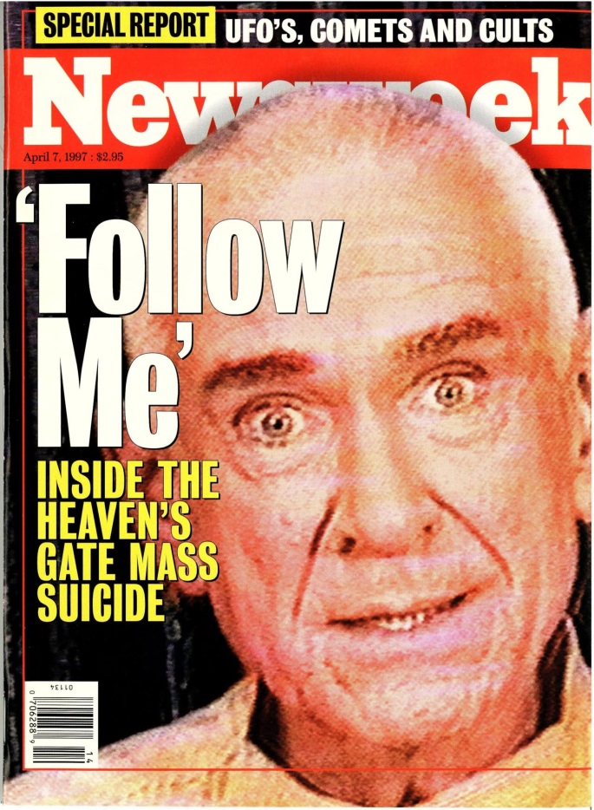
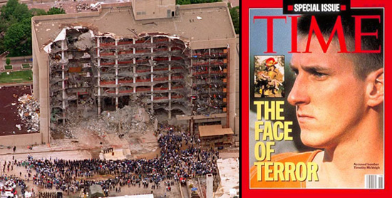
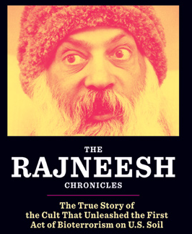
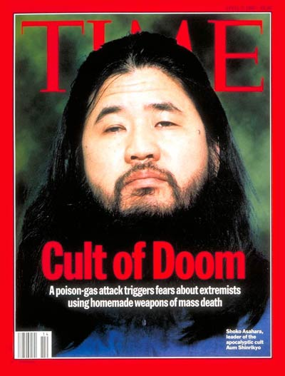
Extremist
a person who holds extreme or fanatical political or religious views, especially one who resorts to or advocates violence.
Notes:
The Heaven’s Gate cult committed mass suicide with the appearance of the Hale-Bopp comet that they felt would take them to enlightenment. The Rajneesh cult was located in Oregon and attempted to give the local community food poisoning in order to win local elections. Timothy McVeigh’s views on government lead him to bomb a federal building in Oklahoma city. Shoko Asahara was the leader of a doomsday cult in Japan that launched a sarin gas attack on the Tokyo subway system.

