Slide 1
Russian Demographics
Loss of Communist safety net has had huge effects on Russian demographics.

Slide 2
Factors/Result
Increased non-natural deaths associated with alcoholism, drugs, and sexually transmitted diseases.
Lowest birthrate on the planet
Highest abortion rate on the planet.
Uncertain economic future= lower fertility.
Result: Death rate is higher than birthrate so Russia’s population is decreasing.

Slide 3
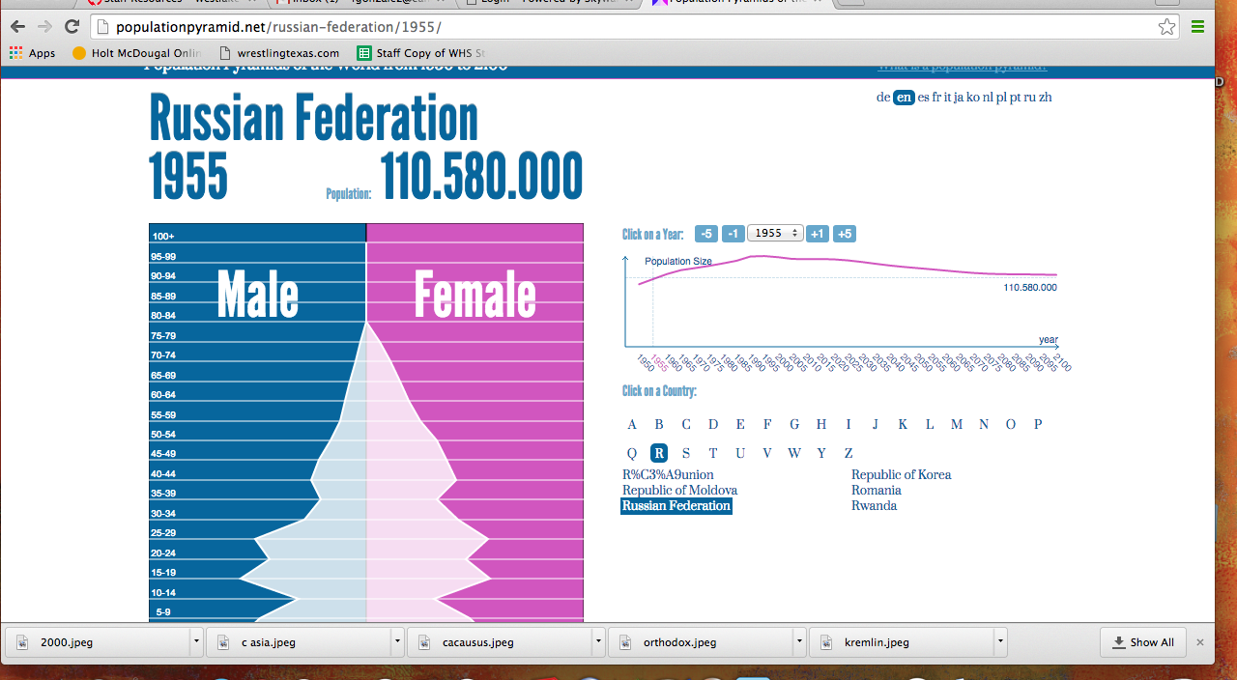

Slide 4
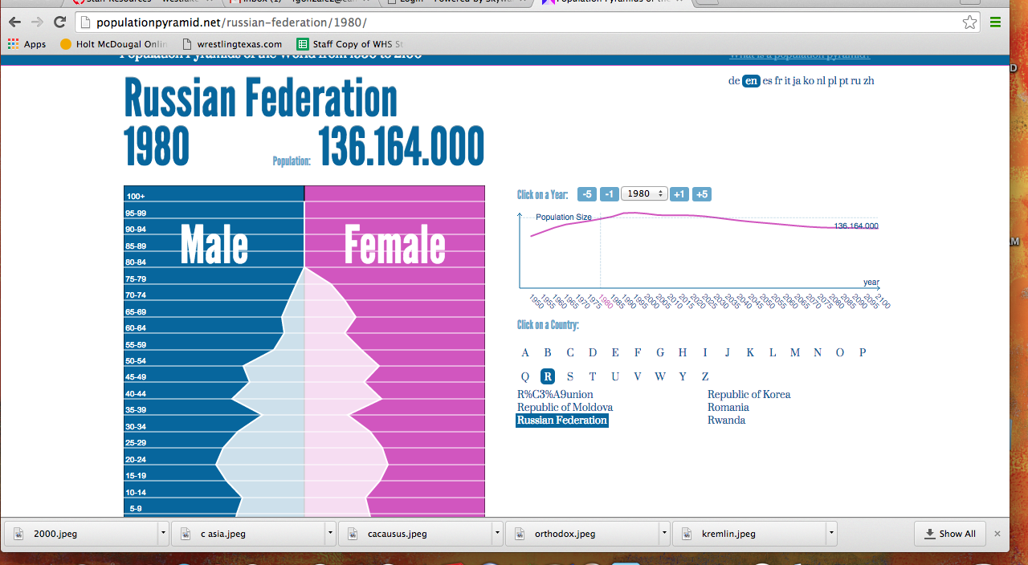

Slide 5
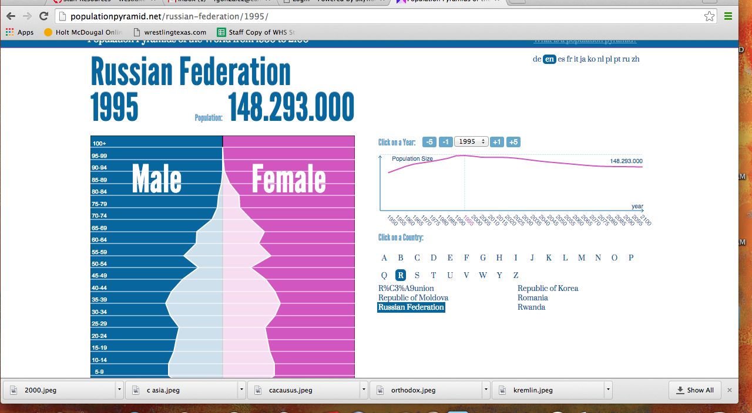

Slide 6
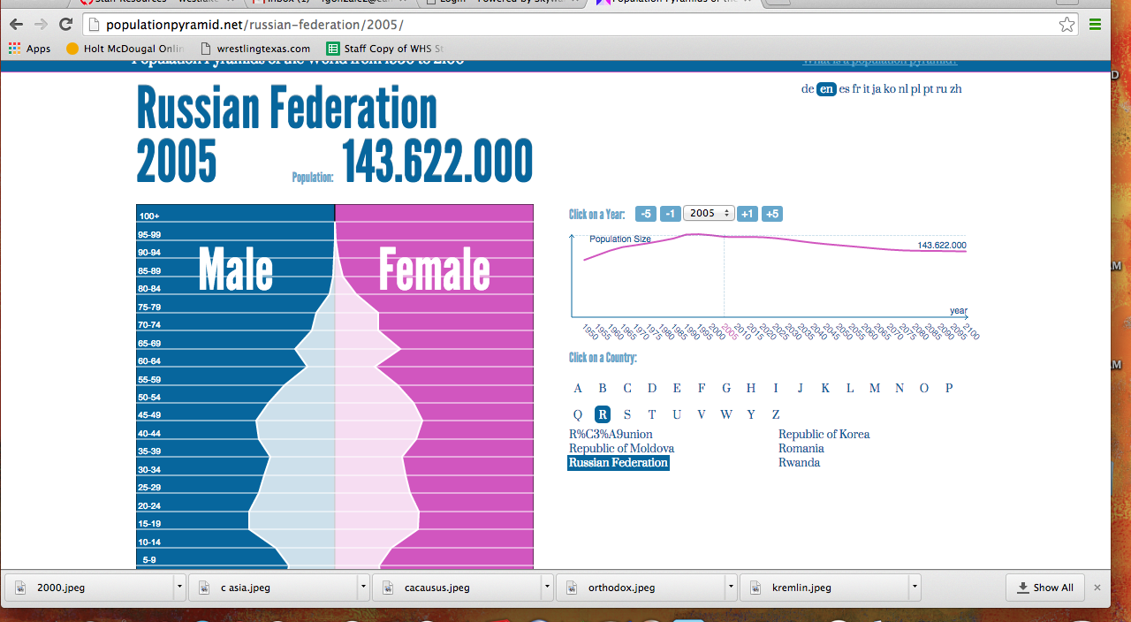

Slide 7
