Slide 1
Landforms and Geo Terminology

Slide 2
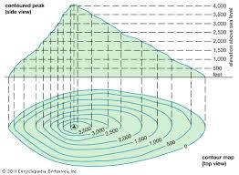
Releif
The difference in elevation from its lowest point to its highest point.

Slide 3
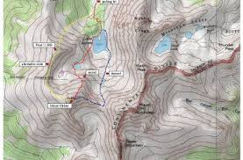
Topography
The combination of the surface shape and composition of the landforms.

Slide 4
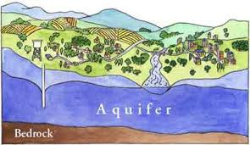
Aquifer
An underground layer of water-bearing permeable rock, from which groundwater can be extracted.

Slide 5
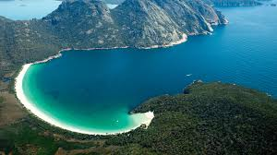
Bay
Part of an ocean or lake partially enclosed by land.

Slide 6
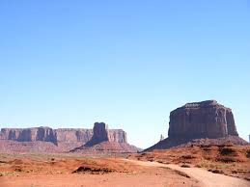
Butte
A raised, flat area of land with steep cliffs, smaller than a mesa.

Slide 7
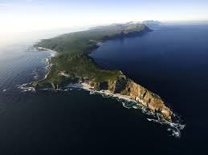
cape
A point of land extending into an ocean or lake

Slide 8
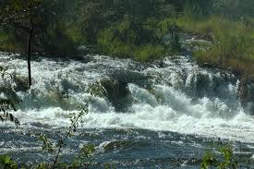
Cataract
Its like a waterfall or series of waterfalls.

Slide 9
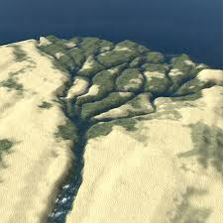
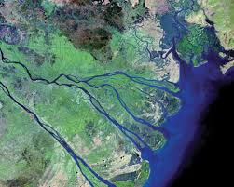
Delta
A triangular area of land form from silt deposits at the mouth of a river.

Slide 10
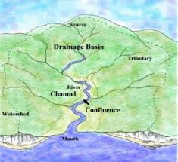
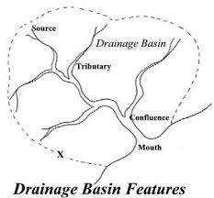
Drainage Basin
A catchment basin where surface water converges to a point.

Slide 11
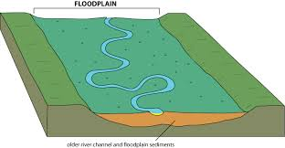
Flood plain
Flat land near the edges of rivers formed by mud and silt deposited from floods.

Slide 12
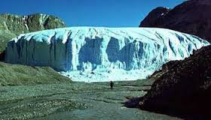
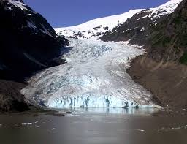
Glacier
A large ice mass that moves slowly down a mountain or over land.

Slide 13
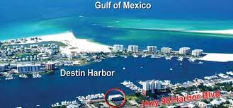
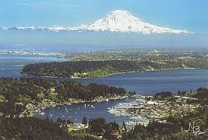
Harbor
A sheltered area of water deep enough for docking ships.

Slide 14
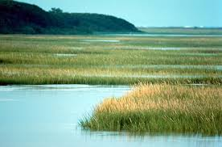
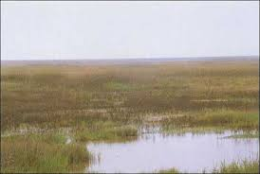
Marsh
Soft, wet low lying, grassy land that serves as a transition between water and land.

Slide 15
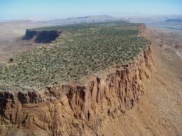
Mesa
A wide, flat topped mountain with steep sides, larger than a butte.

Slide 16
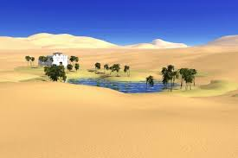
Oasis
A spot of fertile land in a desert, fed by water from wells or underground springs

Slide 17
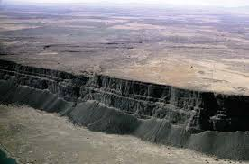
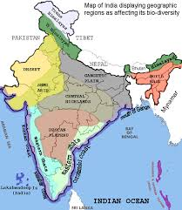
Plateau
A broad, flat area of land higher than the surrounding land.

Slide 18
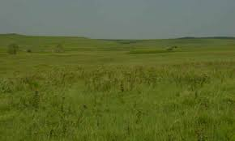
Prairie
A large, level area of grassland with few or no trees

Slide 19
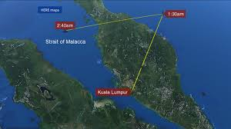
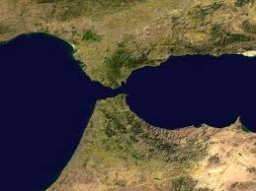
Stait
A narrow channel connecting two larger bodies of water

Slide 20
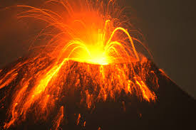
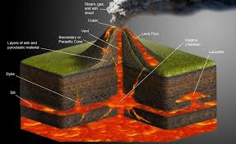
Volcano
Occurs when magma, gases, and water from the lower part of the earth’s crust pour out of a crack in the earth’s surface.

