Slide 1
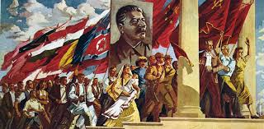
Cultural Geography of Northern Eurasia

Slide 2
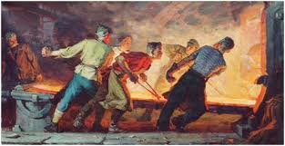
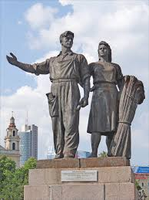
Soviet Effect on the Arts
Socialist Realism
Notes:
Socialist Realism was the only approved style of art by the Communist Party.

Slide 3
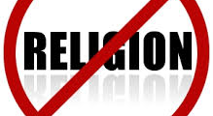
Soviet Effect on religion
Notes:
Religion was discouraged under Soviet rule. Karl Marx said it “was an opiate of the masses”.

Slide 4
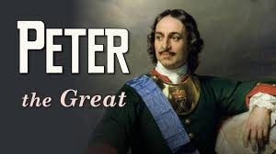
Enlightened Czar of Russia---Wanted Russia to be more like Europe.

Slide 5
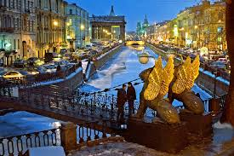
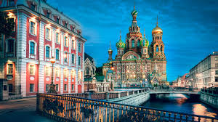
“Window to the West St. Petersburg
Notes:
Peter the Great was an enlightened monarch. He wanted Russia to be more like Europe. So he transformed St. Petersburg to model Europe. It was his “Window to the West”

Slide 6
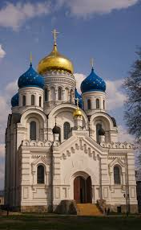
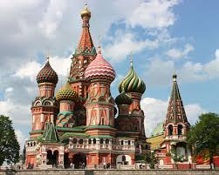
Russian Orthodox
Notes:
Look for the onion shaped domes

Slide 7
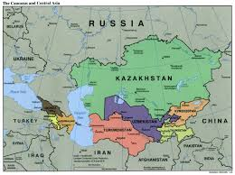
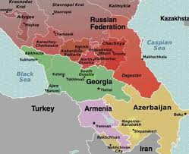
Islam in N. Eurasia
Islam can be found in Central Asia and the Caucasus region.
Notes:
These regions border SW Asia

