Slide 1
Cultural Geography

Slide 2
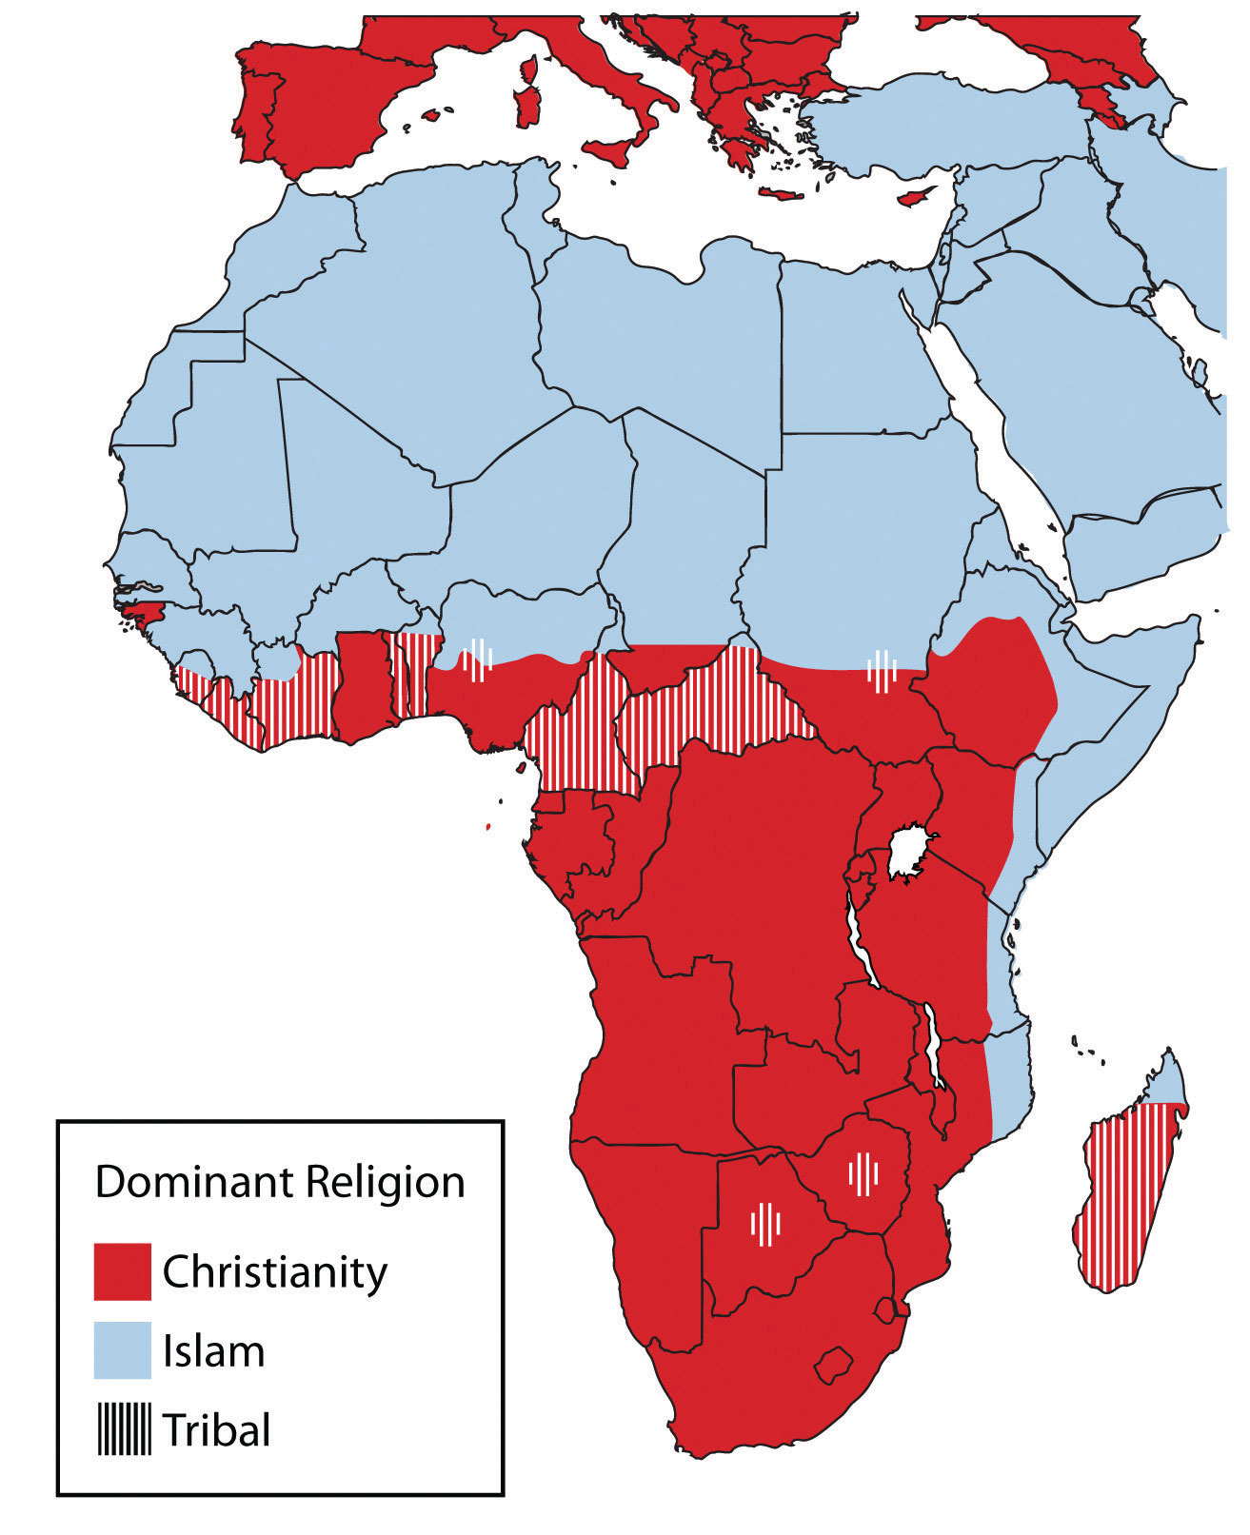
Distribution of Religions
Traditional

Slide 3
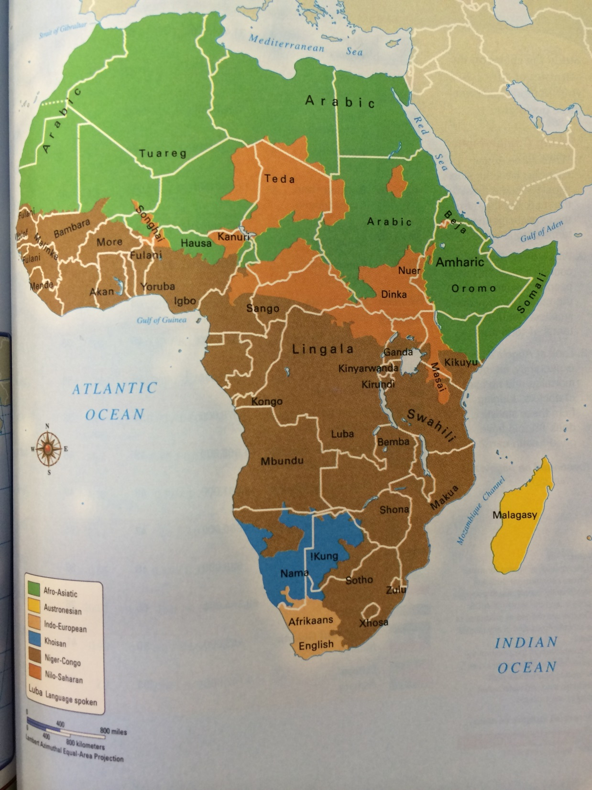
Distribution of major language families
Green: Arabic
Brown: Niger-Congo
Blue: Khoisan
Yellow: Austronesian
Tan: Indo-European

Slide 4
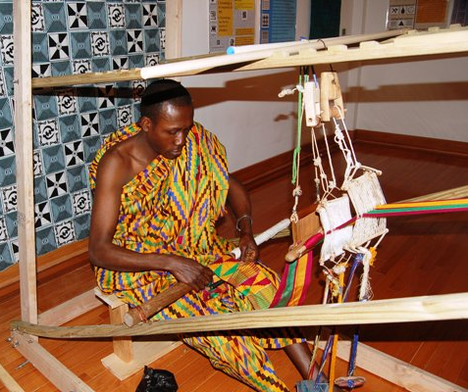
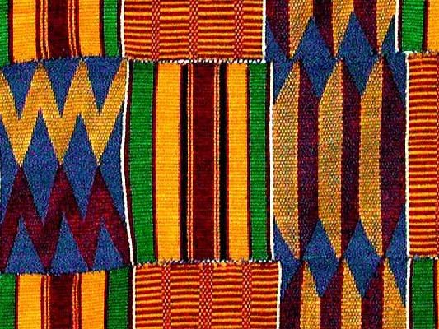
Ashanti / Kente Cloth

Slide 5
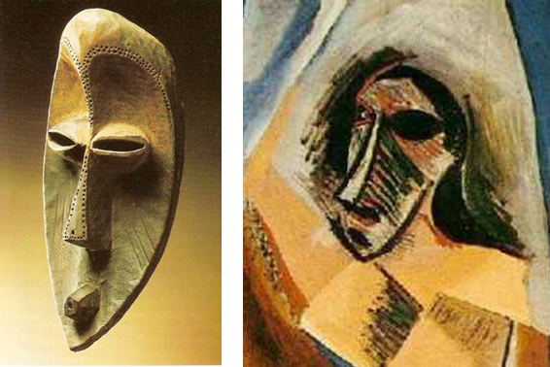
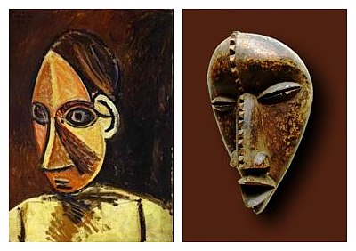
Fang Sculpture & influence on Pablo Picasso

Slide 6
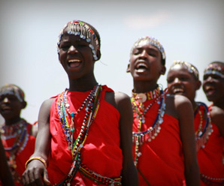
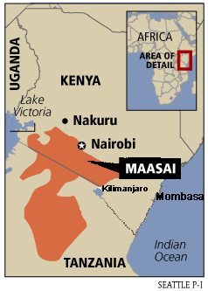
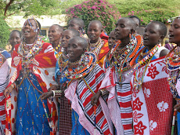
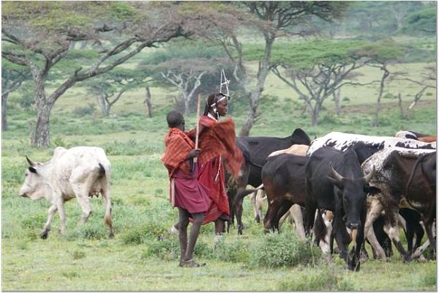
Masai (cattle culture)

