Slide 1
Africa Visual Literacy

Slide 2
Distribution of Religions in Africa
Notes:
Most people in North Africa are Muslim.
In Sub-Saharan Africa, the majority of the people are Christian.
Missionaries from other parts of the world brought Christianity to Africa.
Some people in Sub-Saharan Africa choose to follow traditional religions.
Countries that are in the transition zone between Islam and Christianity are more likely to experience ethnic and religious conflict.

Slide 3
African Language Map
Notes:
More than 1,000 different languages are spoken in Africa.
Although most countries in Africa have adopted colonial European languages for official government business, most people speak indigenous (local) languages.
Most people in North Africa speak Arabic and are Muslim.

Slide 4
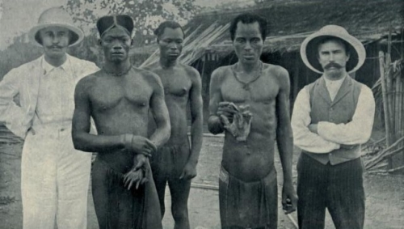
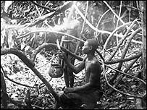
King Leopold II of Belgium
Notes:
King Leopold controlled the Congo as his personal possession and made a fortune for himself from the harvest of wild rubber. Villagers were rounded up, the men sent into the forests to harvest rubber, and the women and children held as hostages until the quota was filled.
Under Belgian King Leopold’s rule, half the population of the Congo—as many as 8 million people--died. Some were killed for failing to meet the quotas for ivory and rubber, some were worked to death, and some died from the diseases brought to Congo by the Europeans. Baskets of severed hands were presented as evidence of how many people had been killed. (To make up for wasted bullets, hands were cut off and the person left to survive.)
This has been termed a “colonial genocide.”

Slide 5
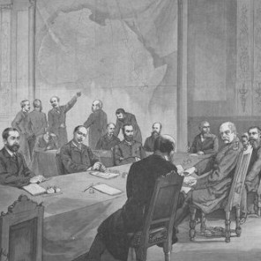
The Berlin Conference—1884-1885
Notes:
.
In 1884 at the request of Portugal, German chancellor Otto von Bismark called together the major western powers of the world to negotiate questions and end confusion over the control of Africa. Bismark appreciated the opportunity to expand Germany's sphere of influence over Africa and desired to force Germany's rivals to struggle with one another for territory. The map shows how the Berlin Conference that ended in 1885 carved up Africa
At the time of the conference, 80% of Africa remained under traditional and local control. What ultimately resulted was a hodgepodge of geometric boundaries that divided Africa into fifty irregular countries. This new map of the continent was superimposed over the one thousand indigenous cultures and regions of Africa. The new countries lacked rhyme or reason and divided coherent groups of people and merged together disparate groups who really did not get along.
The Berlin Conference was Africa's undoing in more ways than one. The colonial powers superimposed their domains on the African continent. By the time independence returned to Africa in 1950, the realm had acquired a legacy of political fragmentation that could neither be eliminated nor made to operate satisfactorily."*

Slide 6
African primate cities
What is a primate city? Why does Africa have so many primate cities?
Notes:
There were no large urban settlements in Africa when the Europeans created colonies. They built port cities and infrastructure to get the raw materials out of the colonies while the rest of the colony was left without transportation systems. True urban hierarchies were not established in African countries.

Slide 7
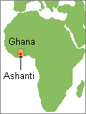
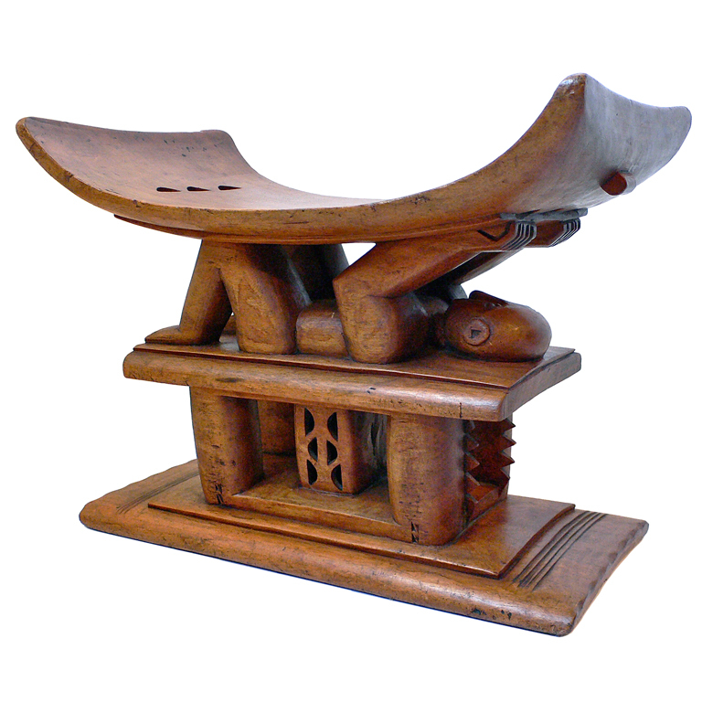
Ashanti crafts
Notes:
The Ashanti are the largest tribe in Ghana and one of the few matrilineal societies in West Africa. Once renowned for the wealth of their rulers, they are most famous today for their crafts work, including hand carved stools and colorful kente cloth. Kente cloth is woven in bright, narrow strips with complex patterns. It is usually made from cotton and is woven exclusively by men.

Slide 8
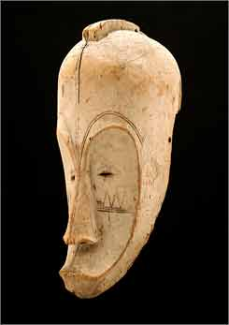
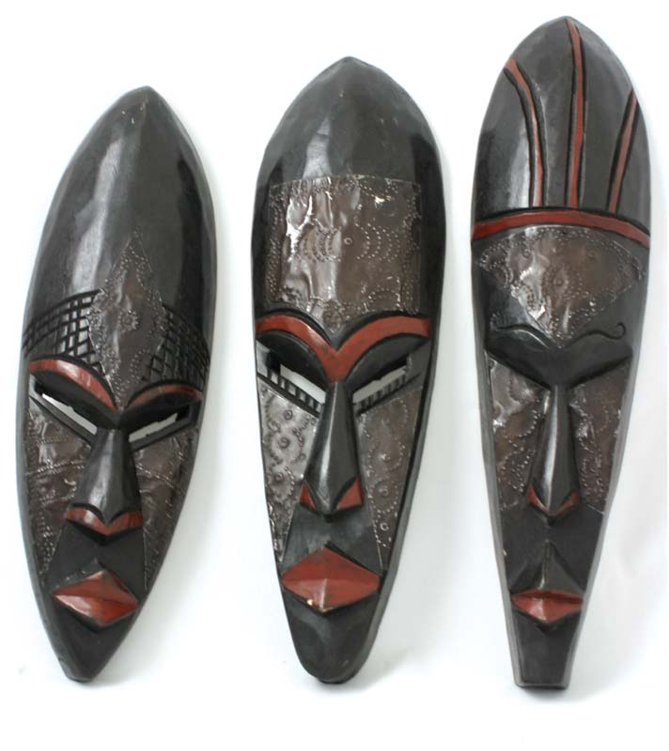
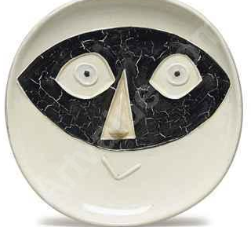
Fang Ceremonial Masks
Can you spot the fake?
Notes:
The image to the right is a Picasso—his work was strongly influenced by the Fang.
The Fang occupy a large swath of land across Cameroon, Equatorial Guinea, and Gabon.
Their sculptural art is devoted to the practice ancestor worship.

Slide 9
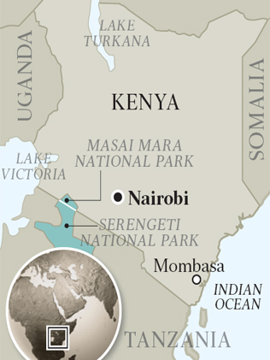
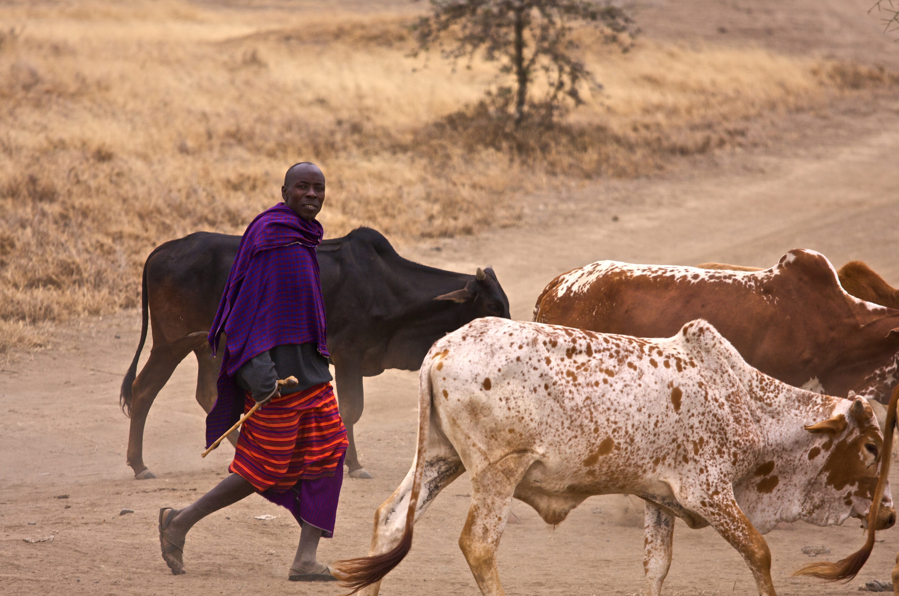
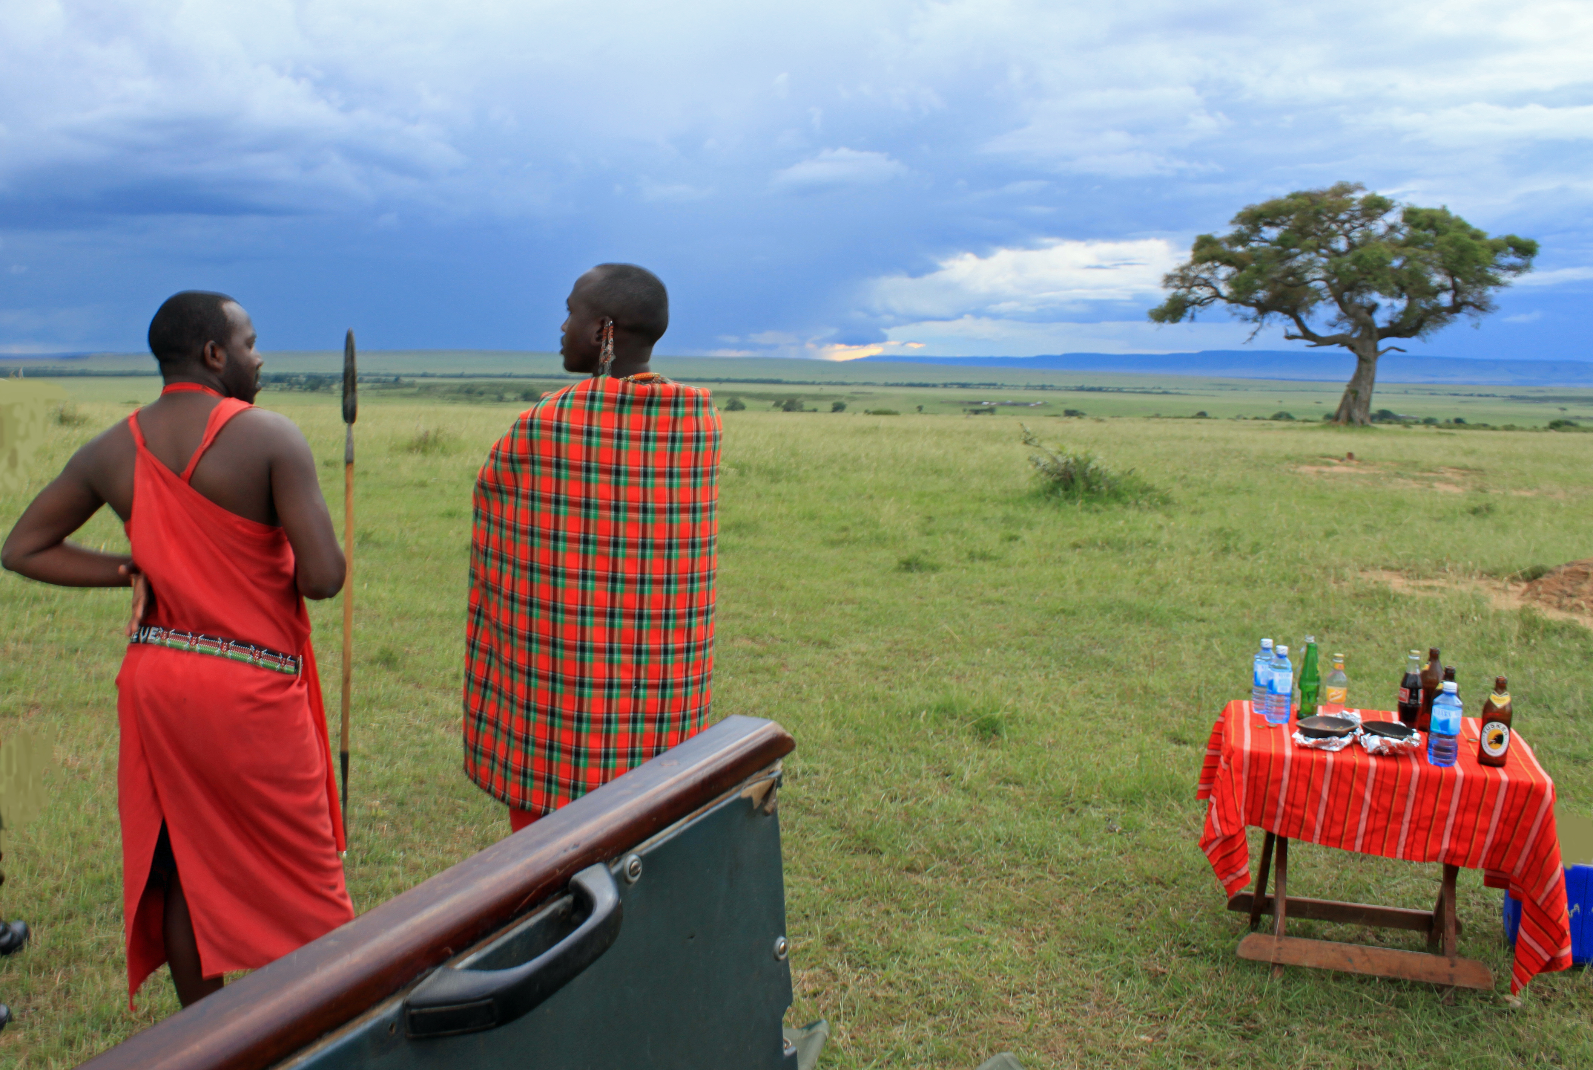
Maasai
Notes:
The Maasai are semi-nomadic people of East Africa who live in southern Kenya and northern Tanzania (along the Great Rift Valley on semi-arid and arid lands.)
Lands are communal and the movement of livestock is based on seasonal rotation. Livestock such as cattle, sheep, and goats are the primary source of income for the Maasai. They are traded for other livestock, cash, or livestock product.
The Maasai are especially known for their bead work and cattle culture.

